Slide 1

ECE 2700
Digital Circuits
Boolean Logic
Copyright © 2010 Frank Vahid
Instructors of courses requiring Vahid's Digital Design textbook (published by John Wiley and Sons) have permission to modify and use these slides for customary course-related activities, subject to keeping this copyright notice in place and unmodified. These slides may be posted as unanimated pdf versions on publicly-accessible course websites.. PowerPoint source (or pdf with animations) may not be posted to publicly-accessible websites, but may be posted for students on internal protected sites or distributed directly to students by other electronic means. Instructors may make printouts of the slides available to students for a reasonable photocopying charge, without incurring royalties. Any other use requires explicit permission. Instructors may obtain PowerPoint source or obtain special use permissions from Wiley – see http://www.ddvahid.com for information.

Slide 2
Today’s Objectives
To become familiar with basic logic gates
  NOT gates
  AND gates
  OR gates
To know how to build a simple circuit using logic gates

Slide 3
Digital Design
analog
phenomena
sensors and
other inputs
electric
digital
signal
data
A2D
digital
data
Microprocessor or custom circuit
Digital System
digital
digital
data
data
D2A
electric
signal
Built using (billions of) transistors
actuators and
other outputs

Slide 4
How Are Transistors Made?
http://www.youtube.com/watch?v=d9SWNLZvA8g&feature=fvwrel

Slide 5
Transistors
A transistor is essentially a switch
  Source input, and output
    Current tries to flow from source input to output
  Control input
    Voltage that controls whether that current can flow
control
input
“off” 0
source
output
input
control
input
“on” 1
source
output
input

Slide 6
CMOS Transistors
MOS—metal oxide semiconductor
A positive
voltage here...
...attracts electrons here,
turning the channel between
the source and drain into
a conductor
gate
o
xide
IC pa
c
kage
sou
r
ce
drain
IC
Silicon – not quite a conductor or insulator
Semiconductor

Slide 7
CMOS Transistors (2)
CMOS—Complementary MOS
  nMOS
  pMOS
nMOS
gate
1
0
conducts
does not
conduct
pMOS
gate
1
0
does not
conducts
conduct

Slide 8

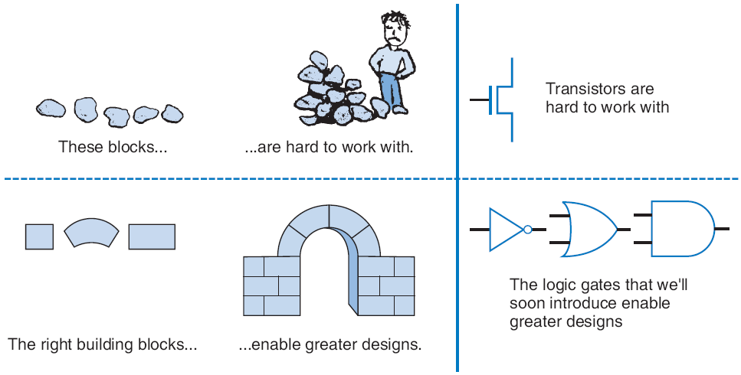


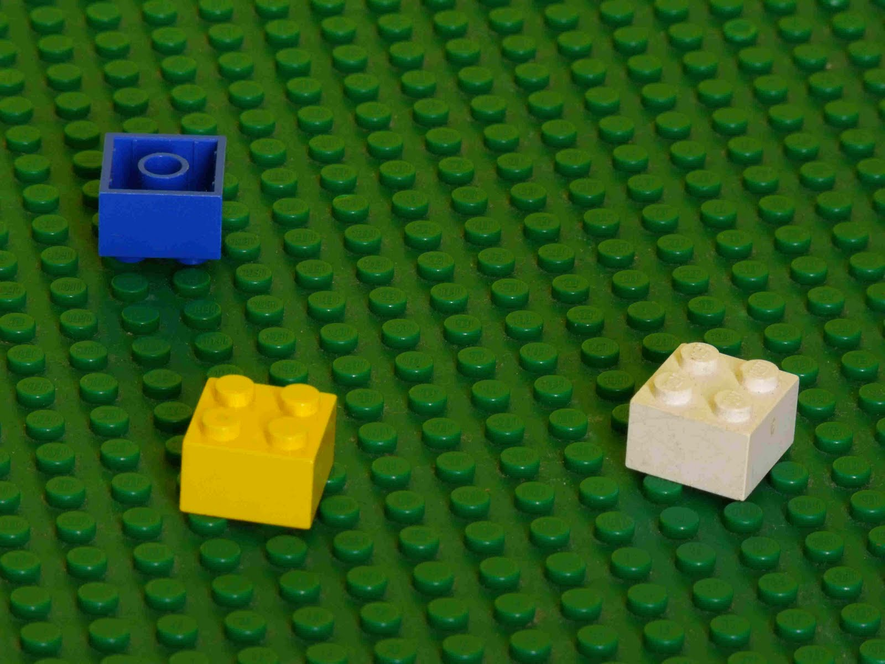
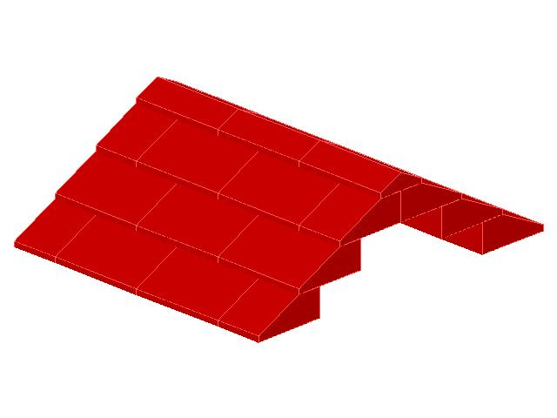
Boolean Logic Gates
Simple circuit components

Slide 9
What is Boolean Algebra?
Traditional algebra
  Variables represent real numbers
    x, y
  Operators operate on variables, return real numbers
    2.5 x + y - 3
Boolean Algebra
  Variables represent 0 or 1 only (i.e., false or true)
  Operators return 0 or 1 only
  Basic operators
    AND
    OR
    NOT

Slide 10
Why Boolean Algebra?
Example
  I will have a nice Saturday if my refrigerator is stocked and I get to watch TV
    If my refrigerator is full, R = 1, otherwise, R = 0
    If I get to watch TV, W = 1, otherwise, W = 0
    F = W and R
Boolean algebra has many nice properties we can use

Slide 11
Relating Boolean Algebra to Digital Design
Logic gates: Boolean operators implemented using transistors
Lets us build circuits by doing math – powerful concept

Slide 12
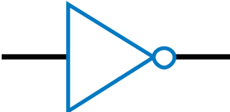
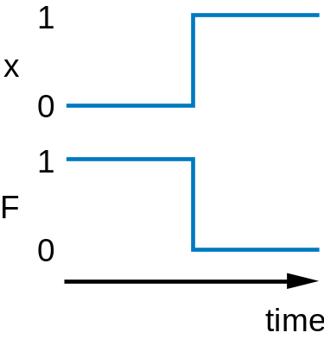
NOT Gate
1
1
x
F
0
1
x
0
1
1
F
x
F
1
0
0
0
0
(
a
)
b
(
)
When the input is 0
When the input is 1
nMOS conducts when input is 1
pMOS conducts when input is 0

Slide 13
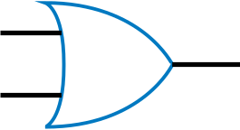
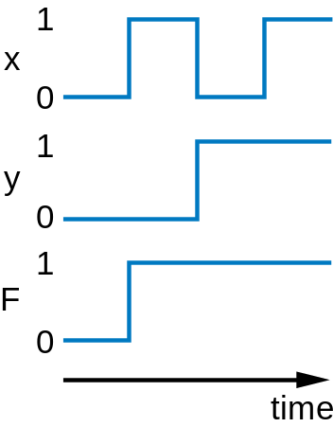
OR Gate
0
0
x
y
F
0
0
0
1
y
0
y
0
1
1
1
0
1
0
x
0
x
1
0
1
1
1
F
F
x
0
1
y
x
0
0
y
1
1
(
a
)
(
b
)
When an input is 1
When both inputs are 0
nMOS conducts when input is 1
pMOS conducts when input is 0

Slide 14
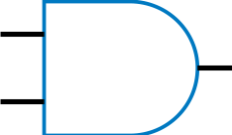
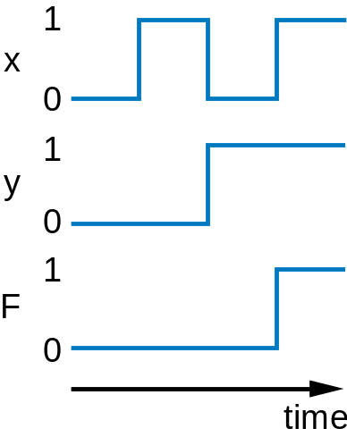
AND Gate
x
y
F
0
0
0
0
0
0
1
0
1
1
x
0
1
y
x
y
1
0
0
F
1
1
1
F
1
y
1
1
y
0
1
x
0
x
1
1
(
a
)
(
b
)
When both inputs are 1
When an input is 0
nMOS conducts when input is 1
pMOS conducts when input is 0

Slide 15
Evaluating Boolean Equations
Evaluate the Boolean equation F = (a AND NOT(b)) OR (c AND d) for the given values of variables a, b, c, and d
  Q1: a=1, b=0, c=1, d=0
    Answer: F = (1 AND NOT(0)) OR (1 AND 0) = 1 OR 0 = 1
  Q2: a=0, b=1, c=0, d=1
    Answer: F = (0 AND NOT(1)) OR (0 AND 1) = 0 OR 0 = 0
  Q3: a=1, b=1, c=1, d=1
    Answer: F = (1 AND NOT(1)) OR (1 AND 1) = 0 OR 1 = 1

Slide 16
Converting to Boolean Equations
Convert the following English statements to a Boolean equation
  Q1: either a is 1 or b is not 1
  Answer: F = a OR NOT(b)
  Q2: a is not 0
  Answer:
    Option 1: F = NOT(NOT(a))
    Option 2: F = a

Slide 17
Now Let’s Build Circuits Together!
F = a AND (s OR d)
F = (NOT(a) AND NOT(b)) OR (NOT(b) AND c)
F = (a AND b) OR (b AND c) OR (c AND d)
1
2
a
s
F
d

Slide 18
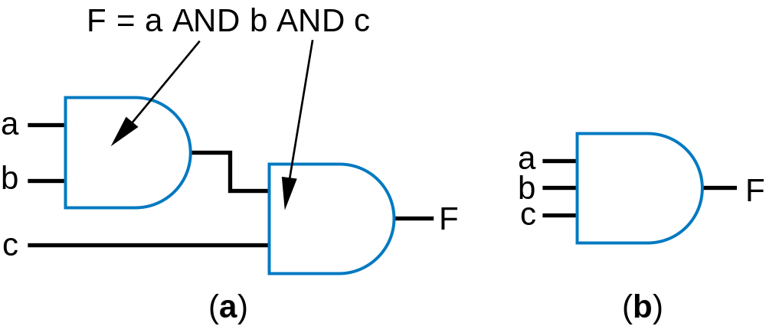
Gates With More Than 2 Inputs
What does the truth table looks like?
  How many rows do we have?
Can think of as AND(a,b,c)

Slide 19
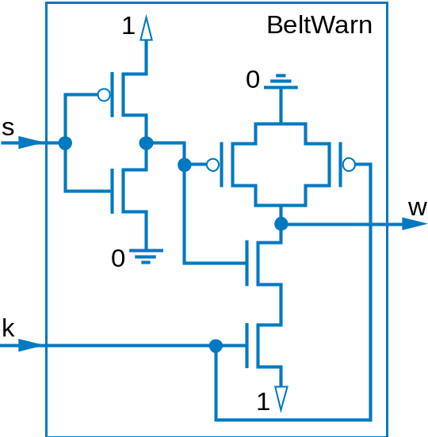
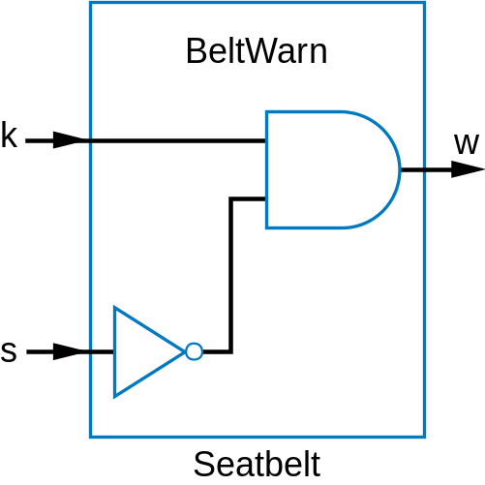
Switches vs. Gates

Slide 20
Gate Drawing Conventions
no
y
es
x
F
y
no
y
es
ok
not ok

Slide 21
Today’s Objectives
To become familiar with basic logic gates
  NOT gates
  AND gates
  OR gates
To know how to build a simple circuit using logic gates

Slide 22
Question
Convert the following English sentence to Boolean equations
  An irrigation system should open the sprinkler’s water valve if the system is enabled, and it doesn’t rain, and the temperature is not freezing
    V: Valve
    E: Enabled
    R: Rain
    F: Freezing temperature

